Slide 1
M.Tech DSE Machine Learning
Dr. Monali Mavani
Source: “Probabilistic Machine Learning, An Introduction”, Kevin P. Murphy, Slides of Prof. Chetana from BITS Pilani and many others who made their course materials freely available online.

Slide 2
Lecture No. – 2 | Math and Stat Preliminaries

Slide 3
Session Content
Linear Algebra Review
Calculus Review
Probability Theory
Decision Theory

Slide 4
Linear algebra Review

Slide 5
Vectors and Matrices
Collections of ordered numbers that represent movements in space, word counts, movie ratings, pixel brightness, etc.
Vector is a mathematical quantity that has magnitude and direction

Slide 6
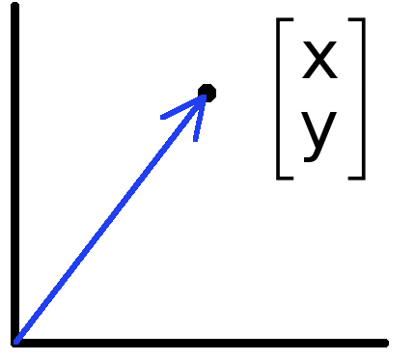
Vectors
Vectors can represent an offset in 2D or 3D space
Points are just vectors from the origin
Data can also be treated as a vector

Slide 7
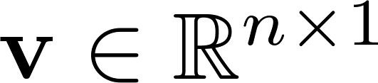
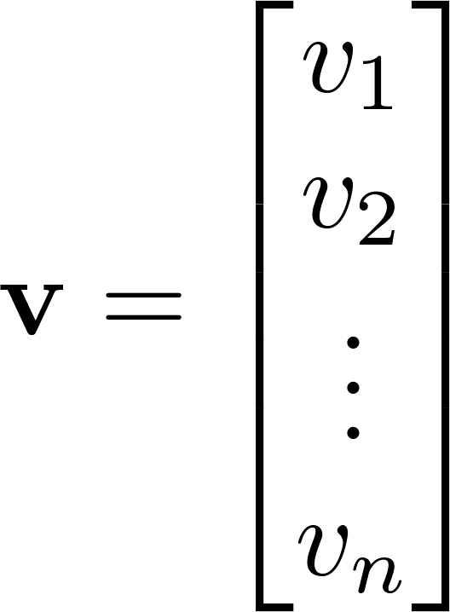
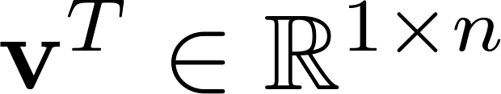
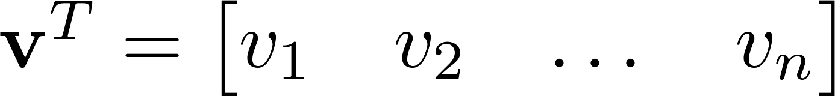

Vector
A column vector where
A row vector where
denotes the transpose operation

Slide 8
Product of 2 Vectors
Three ways to multiply
Element-by-element
Inner product
Outer product
Cross product

Slide 9
Element-by-element product (Hadamard product)

Slide 10
Multiplication: Dot product (inner product)
The dot product represents the similarity between vectors as a single number:
If two vectors are in the same direction the dot product is positive and if they are in the opposite direction the dot product is negative.
1 X N
N X 1
1 X 1
Outer dimensions give
size of resulting matrix
Slide credit: Mark Goldman and Emily Mackevicius

Slide 11
Dot product geometric intuition: “Overlap” of 2 vectors
Slide credit: Mark Goldman and Emily Mackevicius

Slide 12
Example: linear feed-forward network
Input neurons’
Firing rates
r₁
r₂
Synaptic weights
Output neuron’s
firing rate
r_{i}
r_{n}
Slide credit: Mark Goldman and Emily Mackevicius

Slide 13
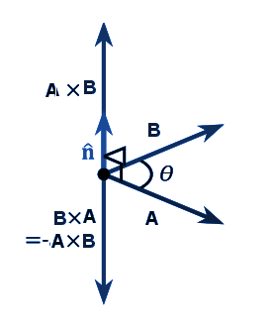
Cross product

Slide 14
Multiplication: Outer product
N X 1
1 X M
N X M
Slide credit: Mark Goldman and Emily Mackevicius

Slide 15
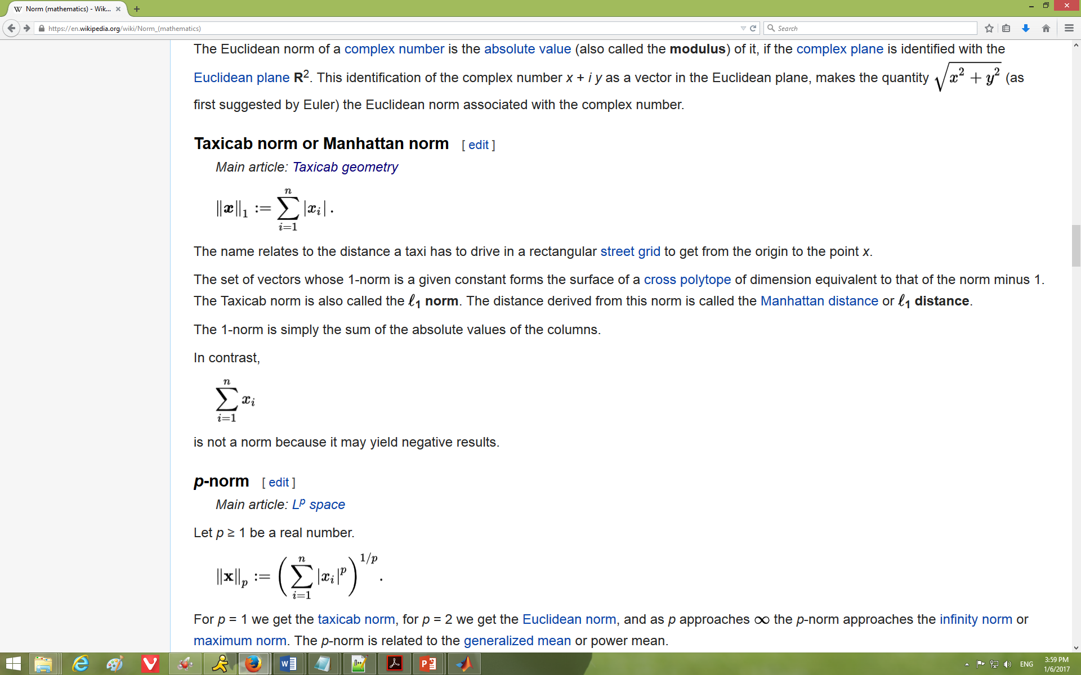
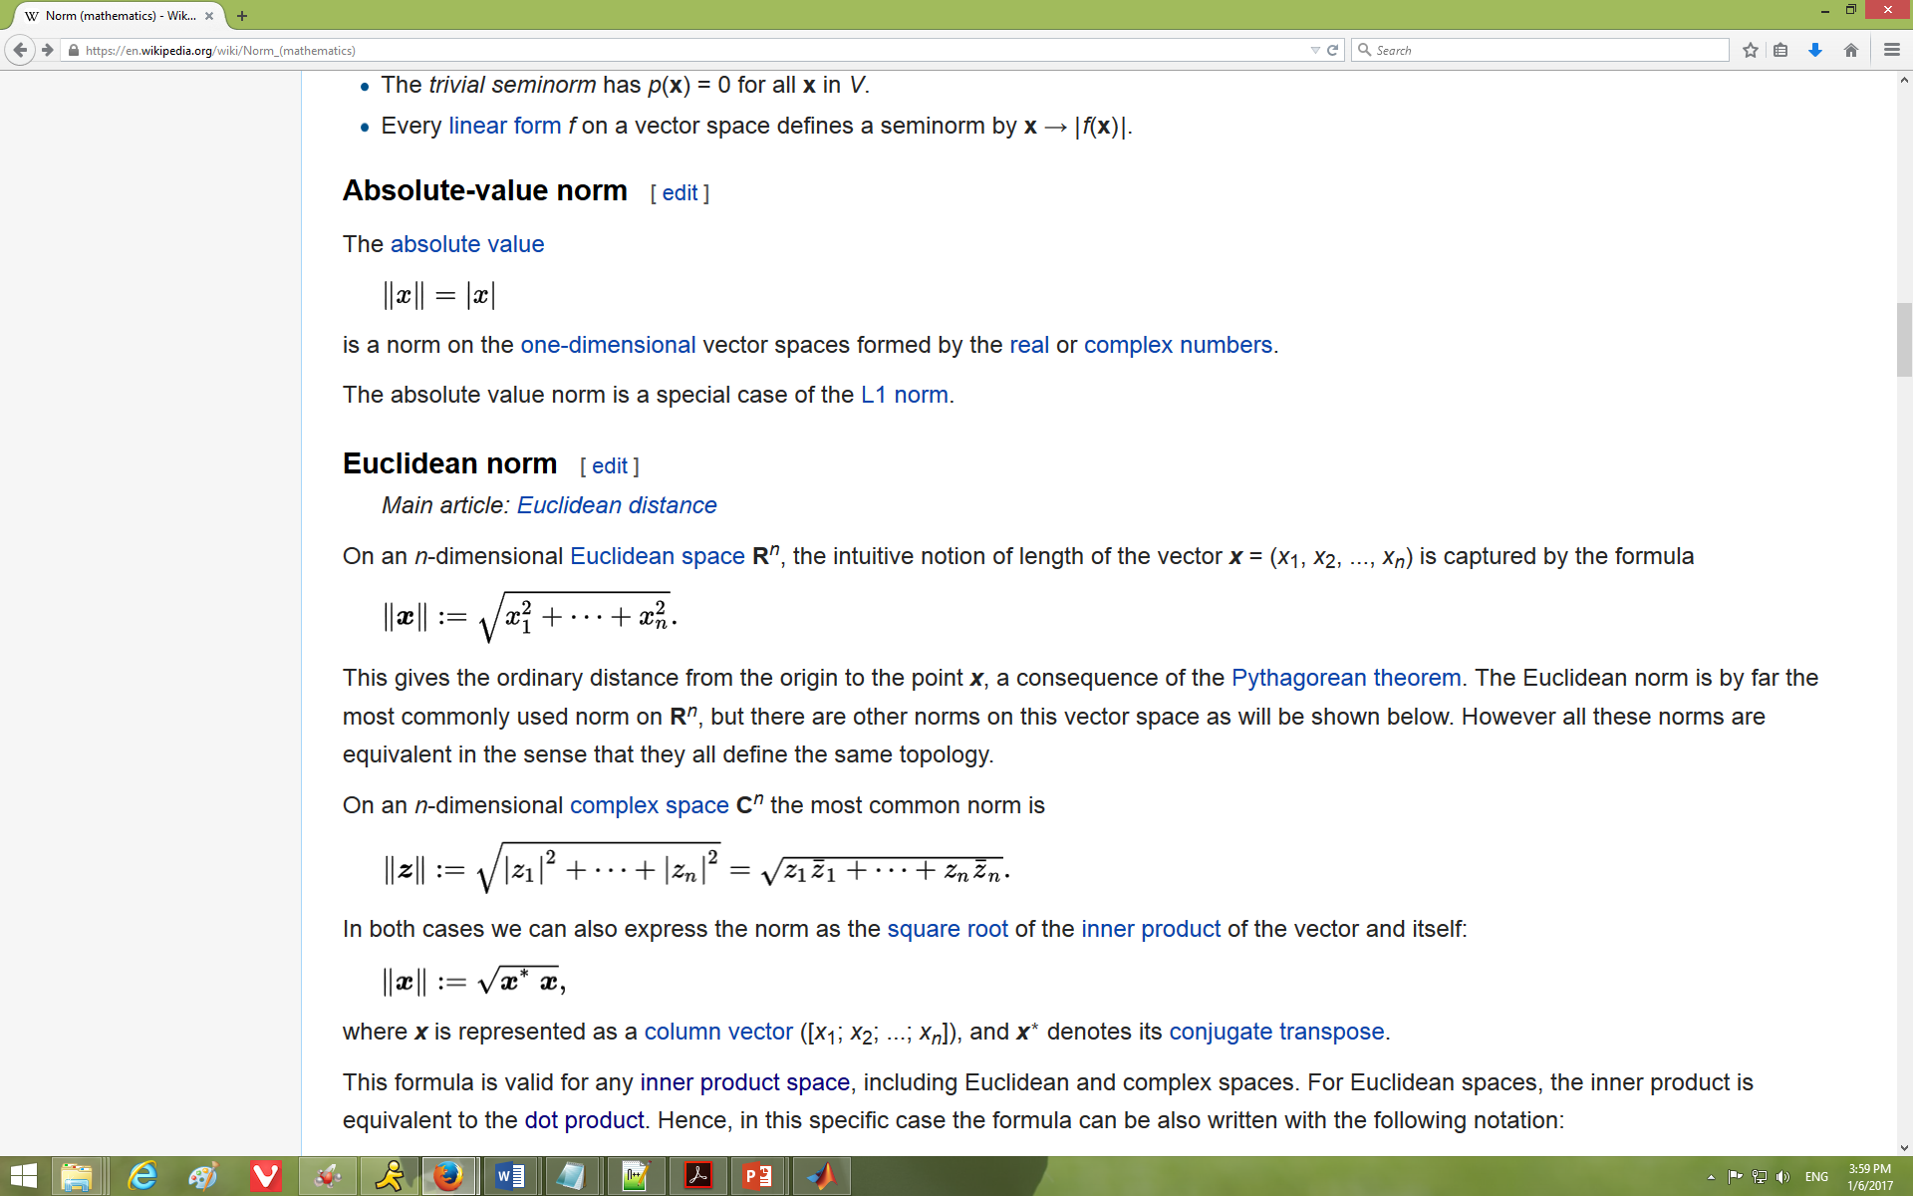
Norm
Norm is a function that assigns a strictly positive length or size to each vector in a vector space—except for the zero vector
L¹ norm - One-dimensional vector spaces, Manhattan/Taxicab Distance, the Mean Absolute Error (MAE), or the Least Absolute Shrinkage and Selection Operator (LASSO)
L² norm - n-dimensional Euclidean space R^{n}, Euclidean Distance, the Mean Squared Error (MSE) / Least Squares Error, or the Ridge Operator

Slide 16
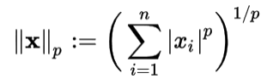
Norm
L^{p} norm - Let p ≥ 1 be a real number. The p norm of vector x=(x₁, x₂,…x_{n})
Matrix norm

Slide 17
Orthogonal and Orthonormal Vectors
A.B=0 then A and B are orthogonal
A collection of vectors a₁, . . . , a_{k} is orthogonal if a_{i} ⊥ a_{j} for any i, j with i ≠ j, i, j = 1, . . . , k.
A collection of vectors a₁, . . . , a_{k} is orthonormal if it is orthogonal and ||a_{i}|| = 1 for i = 1, . . . , k.
normalized or unit vector: A vector of norm one
normalizing : dividing a vector by its norm

Slide 18
Euclidean distance
u and v are n dim vectors

Slide 19
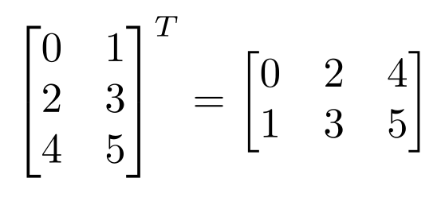
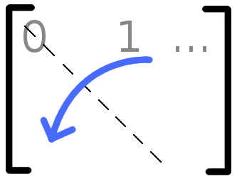
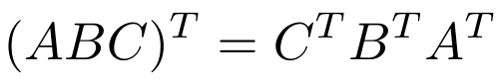
Matrix Operations
Transpose – flip matrix, so row 1 becomes column 1
A useful identity:

Slide 20
Matrix times a vector
M X 1
M X N
N X 1
Slide credit: Mark Goldman and Emily Mackevicius

Slide 21
Matrix times a vector: inner product interpretation
Rule: the i^{th} element of y is the dot product of the i^{th} row of W with x
matrix-vector product is really a dot product in disguise.
Slide credit: Mark Goldman and Emily Mackevicius

Slide 22
Matrix times a vector: outer product interpretation
The product is a weighted sum of the columns of W, weighted by the entries of x
Slide credit: Mark Goldman and Emily Mackevicius

Slide 23
Example: 2-layer linear network
W_{ij} is the connection strength (weight) onto neuron y_{i} from neuron x_{j}.
Slide credit: Mark Goldman and Emily Mackevicius

Slide 24
Example: 2-layer linear network: inner product point of view
What is the response of cell y_{i} of the second layer?
The response is the dot product of the i^{th} row of W with the vector x
Slide credit: Mark Goldman and Emily Mackevicius

Slide 25
Example: 2-layer linear network: outer product point of view
How does cell x_{j} contribute to the pattern of firing of layer 2?
1st column
of W
Contribution
of x_{j} to
network output
Slide credit: Mark Goldman and Emily Mackevicius

Slide 26
Product of 2 Matrices
Note: Matrix multiplication doesn’t (generally) commute, AB ≠ BA
N X P
P X M
N X M
Slide credit: Mark Goldman and Emily Mackevicius

Slide 27
Matrix times Matrix: Matrix Multiplication by inner products
C_{ij} is the inner product of the i^{th} row of A with the j^{th} column of B
matrix product C = AB (denoted without multiplication signs or dots)
Slide credit: Mark Goldman and Emily Mackevicius

Slide 28
Matrix times Matrix: by outer products
C is a sum of outer products of the columns of A with the rows of B
Slide credit: Mark Goldman and Emily Mackevicius

Slide 29
Special matrices: diagonal matrix
This acts like scalar multiplication
Slide credit: Mark Goldman and Emily Mackevicius

Slide 30
Special matrices: identity matrix
for all
A square matrix A is symmetric if A = AT , i.e., Aij = Aji
for all i; j.
Slide credit: Mark Goldman and Emily Mackevicius

Slide 31
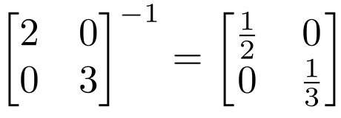
Inverse
Given a matrix A, its inverse A⁻¹ is a matrix such that AA⁻¹ = A⁻¹A = I
E.g.
Inverse does not always exist. If A⁻¹ exists, A is invertible or non-singular. Otherwise, it’s singular.

Slide 32
Different types of product
x, y = column vectors (nx1)
X, Y = matrices (mxn)
x, y = scalars (1x1)
x^{T} y = x · y = inner product (1xn x nx1 = scalar)
x ⊗ y = x y^{T} = outer product (nx1 x 1xn = matrix)
X * Y = matrix product
X .* Y = element-wise product

Slide 33
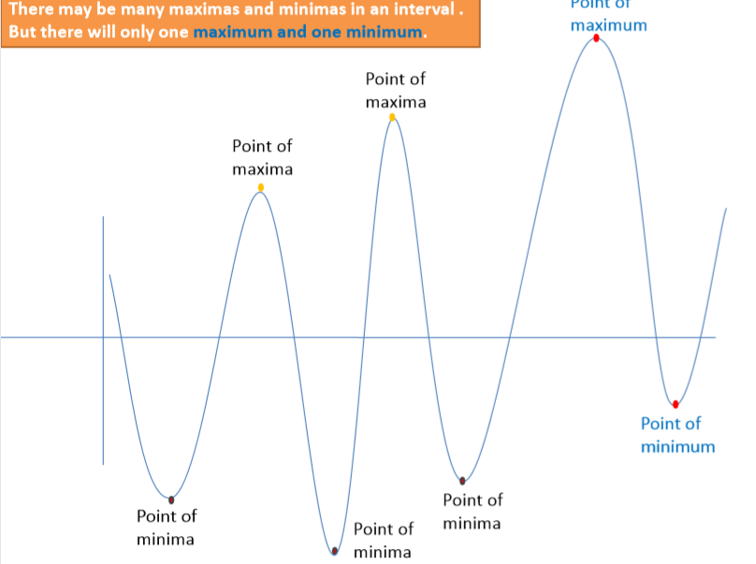
Maxima and Minima of a function

Slide 34
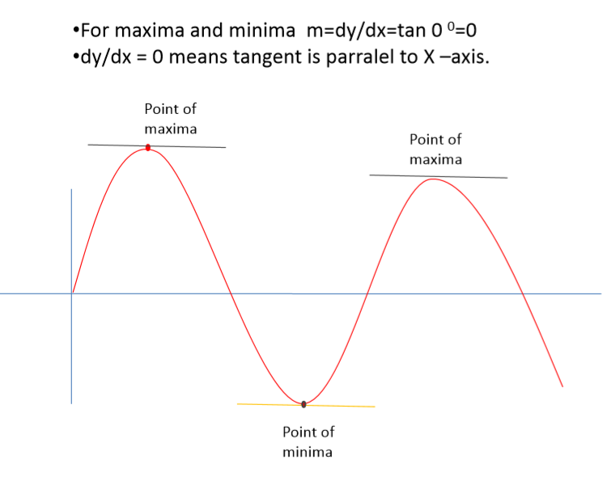
Maxima and Minima

Slide 35
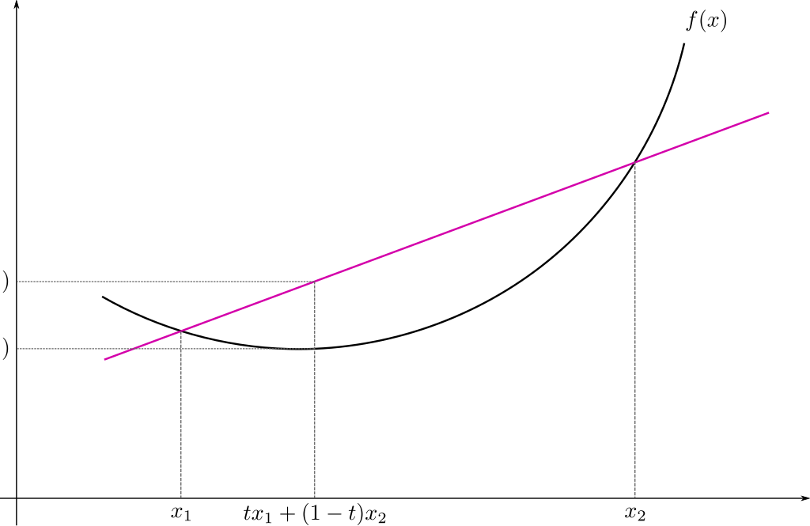
Convex Function

Slide 36
Convex Function
Real-valued function defined on an
n-dimensional interval is called convex if the line segment between any two points on the graph of the function lies above or on the graph

Slide 37
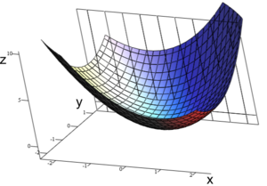
Convex Function : Multivariate

Slide 38
Calculus review

Slide 39
Differentiation
The derivative provides us information about the rate of change of a function.
The derivative of a function is also a function. Example:
The derivative of the acceleration function is the velocity function.
Texas A&M Dept of Statistics

Slide 40
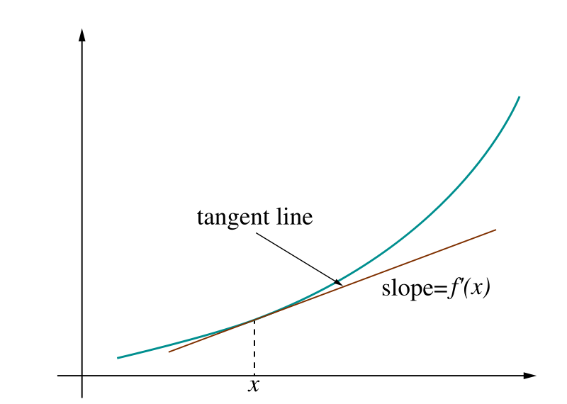
Derivative = rate of change
Image: Wikipedia

Slide 41
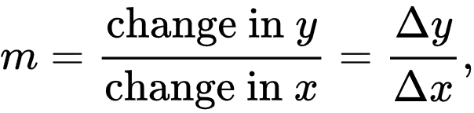
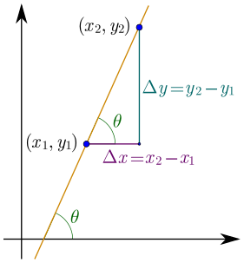
Derivative = rate of change
Linear function y = mx + b
Slope
Image: Wikipedia

Slide 42
Ways to Write the Derivative
Given the function f(x), we can write its derivative in the following ways:
- f '(x)
- ^{d} f(x)
dx
The derivative of x is commonly written dx.
Texas A&M Dept of Statistics

Slide 43
Differentiation Formulas
The following are common differentiation formulas:
- The derivative of a constant is 0.
^{d} c = 0
du
- The derivative of a sum is the sum of the derivatives.
^{d} ( f (u) + g(u)) = f '(u) + g'(u)
du
Texas A&M Dept of Statistics

Slide 44
More Formulas
- The derivative of u to a constant power:
^{d} u^{n} = n *u^{n−1}
du
- The derivative of e:
^{d} e^{u} = e^{u}
du
- The derivative of log:
^{d} log(u) = ¹ du u
Texas A&M Dept of Statistics

Slide 45
Product and Quotient
The product rule and quotient rules are commonly used in differentiation.
- Product rule:
^{d} ( f (u)* g(u)) = f (u)g'(u) + g(u) f '(u)
du
- Quotient rule:
( )
d f (u)
g(u) f '(u) − f (u)g'(u)
=
du g(u)
2
g (u)
Texas A&M Dept of Statistics

Slide 46
Chain Rule
The chain rule allows you to combine any of the differentiation rules we have already covered.
- First, do the derivative of the outside and then do the derivative of the inside.
d
f (g(u)) = f '(g(u))* g'(u)* du
du
Texas A&M Dept of Statistics

Slide 47
Try These
f (z) = z +11
s( y) = 4 ye^{2 y}
log(x² )
g( y) = 4 y³ + 2 y
p(x) =
x
h(x) = e^{3x}
Texas A&M Dept of Statistics

Slide 48
Solutions
f '(z) = 1
s'( y) = 8ye^{2 y}
4e^{2 y}
2 − log(x² )
p'(x) =
_{x}2
g'( y) = 12 y² + 2
h'(x) = 3e^{3x}
Texas A&M Dept of Statistics

Slide 49
Probability Review

Slide 50
Two main "schools of thought"
Bayesian probability= degree of belief
Probabilities are assigned to events based on evidence and personal belief and are centered around Bayes' theorem
p(heads=1)=0.5 means you think the event that a particular coin will land heads is 50% likely.
Frequentist probability= long run frequencies
Events are observed and counted, and their frequencies provide the basis for directly calculating a probability
p(heads=1)=0.5 means that the empirical fraction of times this event will occur across infinitely repeated trials

Slide 51
Probability – Meaning & Concepts
Probability refers to chance or likelihood of a particular event-taking place.
An event is an outcome of an experiment.
An experiment is a process that is performed to understand and observe possible outcomes.
Set of all outcomes of an experiment is called the sample space.

Slide 52
Random Variable
A random variable, usually written X, is a variable whose possible values are numerical outcomes of a random phenomenon or experiment.
Examples
X = number of heads when the experiment is flipping a coin 20 times.
C = the daily change in a stock price.
R = the number of kilometers per litre you get on your car during a family vacation.

Slide 53
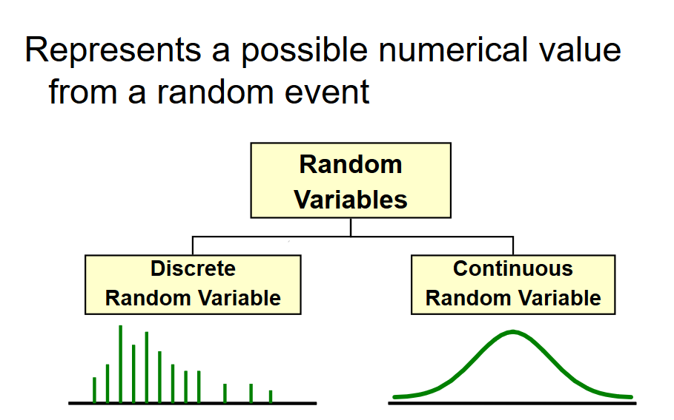
Random Variable

Slide 54
Random Variable
Discrete Random Variable
one that takes on a countable number of values
usually count data [Number of]
list all possible outcomes without missing any of them
Example:
X = sum of values on the roll of two dice:
X has to be either 2, 3, 4, …, or 12.
Y = number of students in MTech DSE:
Y has to be 60,65,70 …………

Slide 55
Random Variable
Continuous Random Variable
Variable that takes on an uncountable number of values
Usually measurement data [time, weight, distance, etc]
You can never list all possible outcomes even if you had an infinite amount of time
Example:
X = time it takes you to drive home from work place: X > 0, might be 30.1 minutes measured to the nearest tenth but in reality the actual time is 30.10000001…………………. minutes?)
Exercise: try to list all possible numbers between 0 and 1

Slide 56
Probability for One Random Variable
For a random variable x, P(x) is a function that assigns a probability to all possible values of x.
Probability Density of x = P(x)
The probability of a specific event A for a random variable x is denoted as P(x = A), or simply as P(A).
Probability of Event A = P(A)

Slide 57
Probability for Multiple Random Variables
Joint Probability( fundamental rule or product rule):
Marginal Probability (sum rule):
Marginal Probability
Conditional Probability:

Slide 58
Probability for Multiple Random Variables – for independent events
Joint Probability:
Marginal Probability:
Conditional Probability:

Slide 59
Probability for Multiple Random Variables – for mutually exclusive events
Joint Probability:
Probability of event A or B:
Probability of event A or B for non mutually exclusive events :

Slide 60
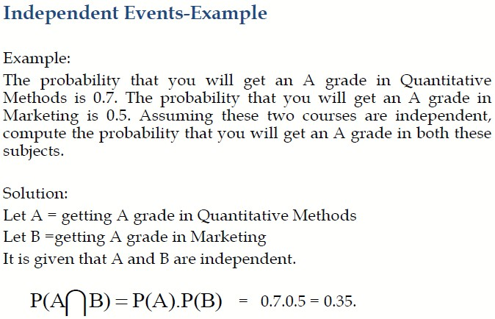

Slide 61
Example
P(Cancer) =1/100
P(+/Cancer)=90/100
P(+/Not Cancer)=8/100
P(Cancer/+)=?

Slide 62
Bayes Rule

Slide 63
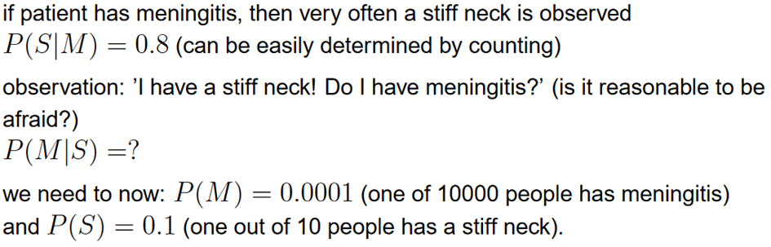
Bayes’ Rule - example

Slide 64
Other Forms of Bayes Rule

Slide 65
More Examples
A = you have the flu, B = you just coughed
Assume:
P(A) = 0.05
P(B|A) = 0.80
P(B| ~A) = 0.20
what is P(flu | cough) = P(A|B)?

Slide 66
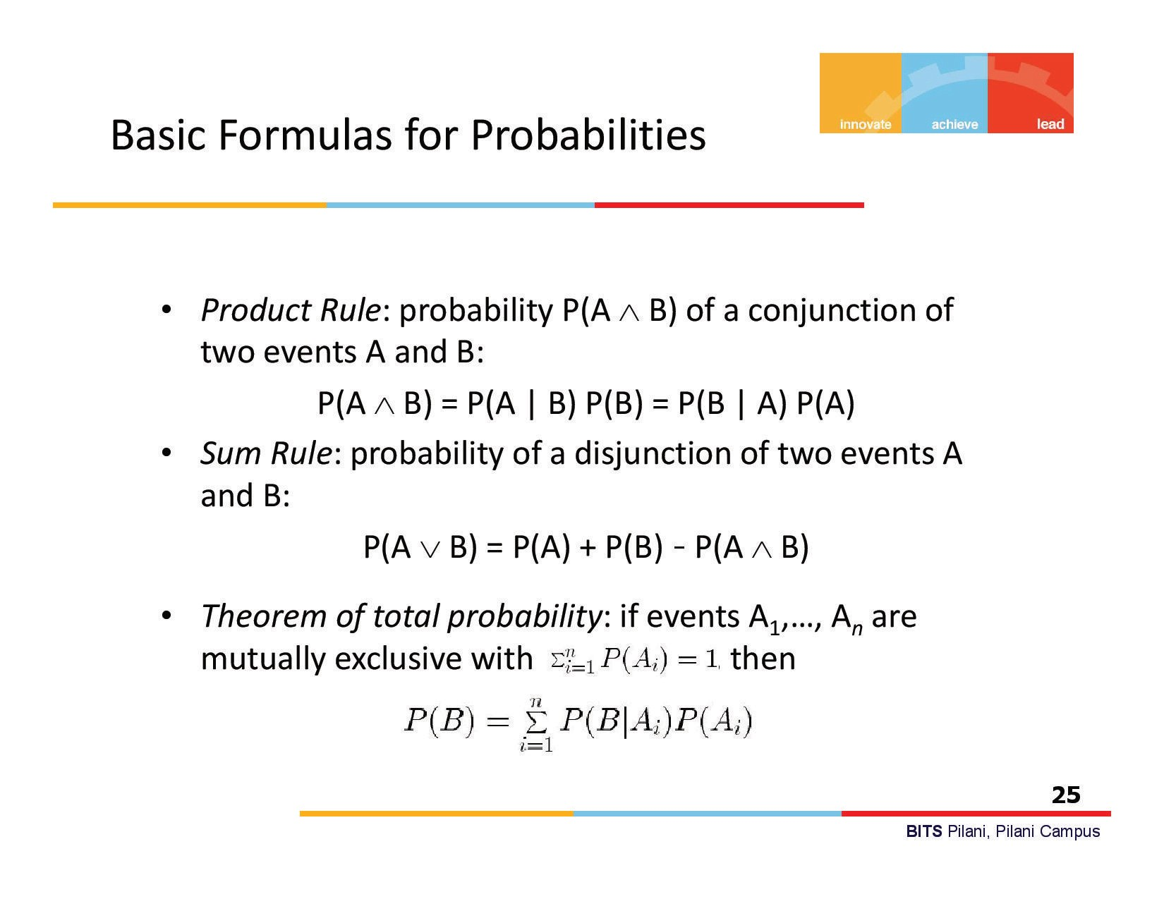

Slide 67
Probability distributions
It is the mathematical function that gives the probabilities of occurrence of different possible outcomes for an experiment.

Slide 68
Probability mass function (pmf) or discrete probability
distribution
A function which computes the probability of events which correspond to setting the rv to each possible value
A uniform distribution with
p(x = k) = 1=4.
A degenerate distribution (delta function) that puts all its mass on x = 1

Slide 69
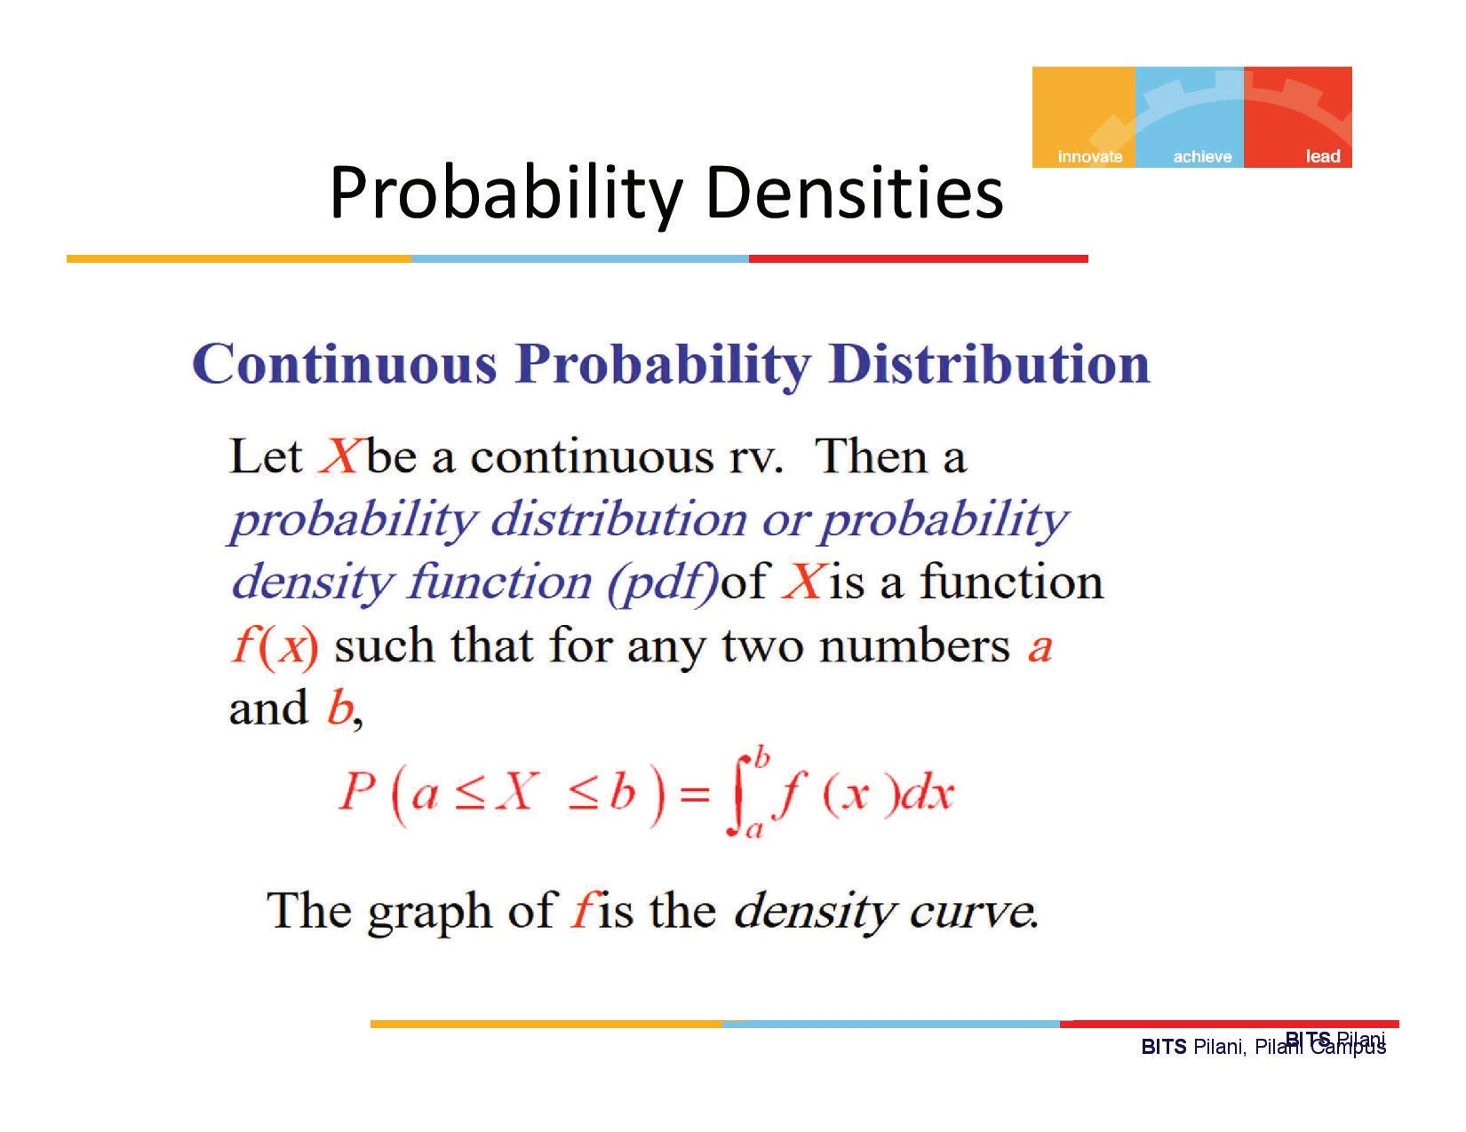

Slide 70
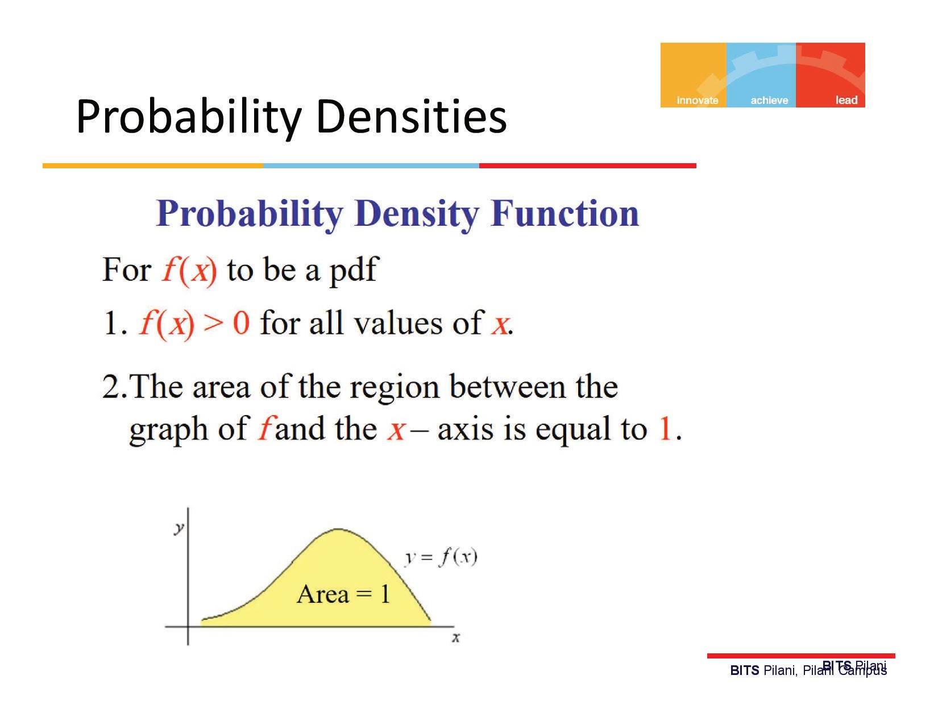

Slide 71
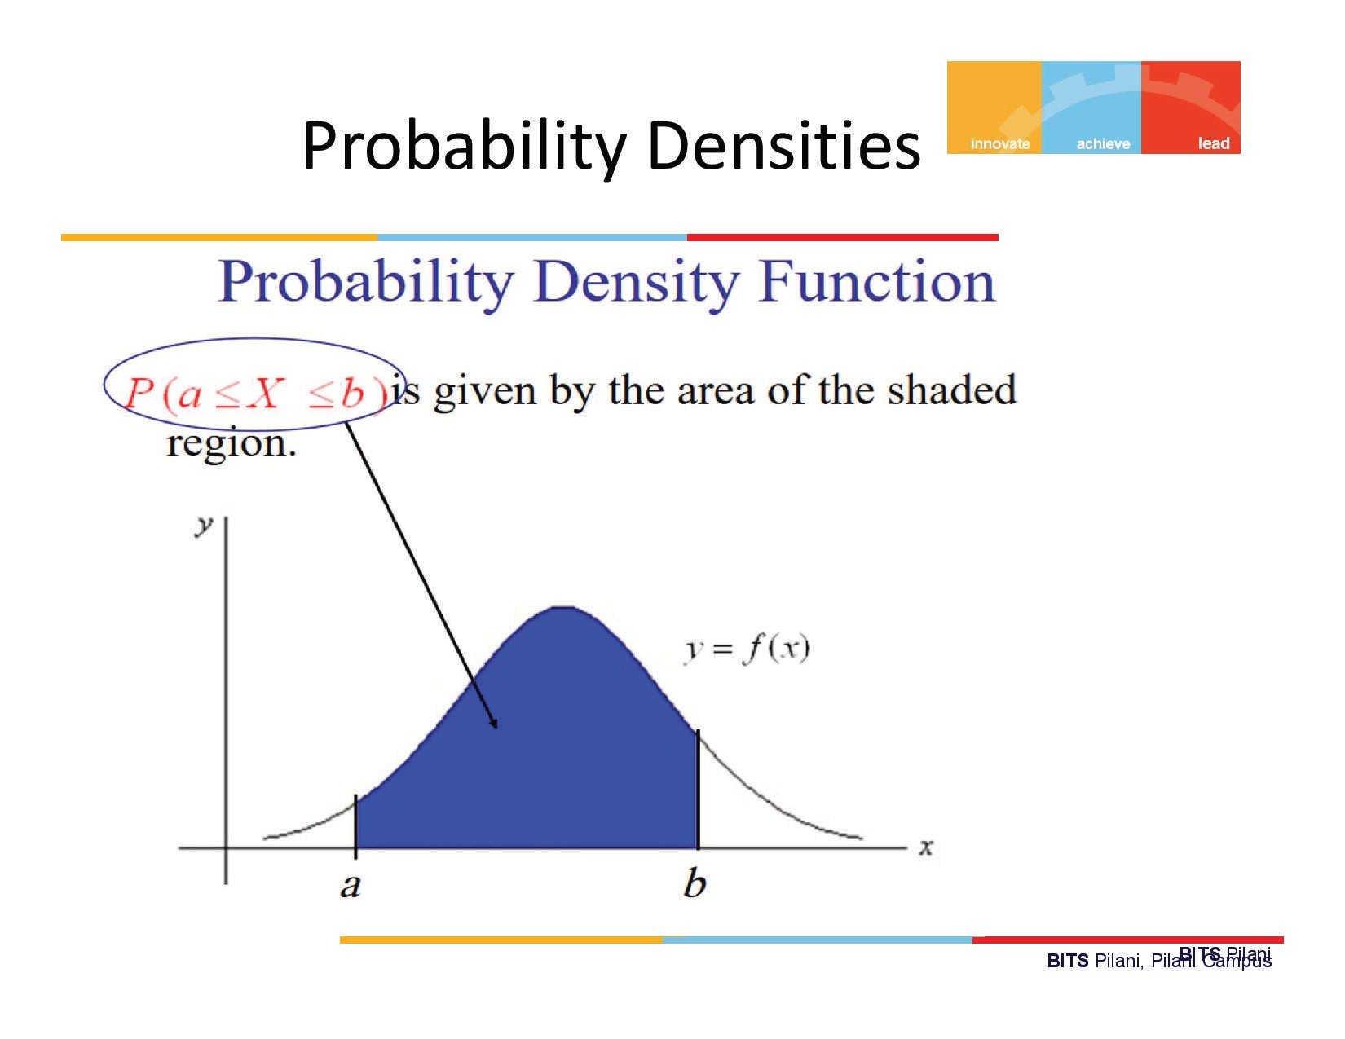

Slide 72
Univariate distributions
A probability distribution whose sample space is one-dimensional (for example real numbers, list of labels)
It gives the probabilities of a single random variable taking on various different values
Important and commonly encountered univariate probability distributions include the binomial distribution, the poisson distribution, and the normal distribution

Slide 73
Multivariate distributions
Sample space is a vector space of dimension 2 or more
A multivariate distribution (a joint probability distribution) gives the probabilities of a random vector – a list of two or more random variables – taking on various combinations of values
A commonly encountered multivariate distribution is the multivariate normal distribution.
It is to find two other types of distributions:
marginal distribution
conditional probability distribution

Slide 74
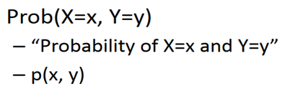
Joint probability distribution
If X and Y are two random variables, the probability distribution that defines their simultaneous behavior is called a joint probability distribution.
If X and Y are discrete, this distribution can be described with a joint probability mass function.
If X and Y are continuous, this distribution can be described with a joint probability density function.

Slide 75
Example
X=disease, y=symptoms

Slide 76
Joint probability distribution - unconditionally independent
We say X and Y are unconditionally independent or marginally independent, we can represent the joint as the product of the two marginals
In general, a set of variables X1; ….. ;Xn is independent if the joint can be written as a product of marginals

Slide 77
Joint probability distribution - conditionally independent
X and Y are conditionally independent (CI) given Z, iff the conditional joint can be written as a product of conditional marginals:

Slide 78
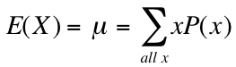
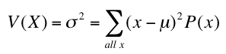
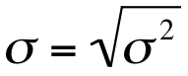
Mean, Variance & Standard Deviation
The mean of a discrete random variable is the weighted average of all of its values. The weights are the probabilities.
This parameter is also called the expected value of X and is represented by E(X).
The variance is
The standard deviation is

Slide 79
Binomial Probability Distribution
A fixed number of observations (trials), n
e.g., 15 tosses of a coin; 20 patients; 1000 people surveyed
A binary random variable
e.g., head or tail in each toss of a coin; defective or not defective light bulb
Generally called “success” and “failure”
Probability of success is p, probability of failure is 1 – p
Constant probability for each observation
e.g., Probability of getting a tail is the same each time we toss the coin

Slide 81
Binomial Probability Distribution
n independent experiments, or trials, Probability of success is p
The total number of successes, X, is a binomial random variable with parameters n and p.
We write: X ~ Bin (n, p) {reads: “X is distributed binomially with parameters n and p}
And the probability that X=r (i.e., that there are exactly r successes)

Slide 82
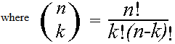
Binomial distribution
Note the general pattern emerging → if you have only two possible outcomes in n independent trials, then the probability of exactly X “successes”=
n = number of trials
1-p = probability of failure
X = # successes out of n trials
p = probability of success

Slide 83
Binomial distribution
If X follows a binomial distribution with parameters n and p: X ~ Bin (n, p)
Then:
μ_{x}= E(X) = np
σ_{x}² =Var (X) = np(1-p)
σ_{x} =SD (X)=

Slide 84
X= the number of heads tossed in 5 coin tosses
Binomial distribution
p(x)
p(x)
x
0
1
2
3
4
5
number of heads
number of heads

Slide 85
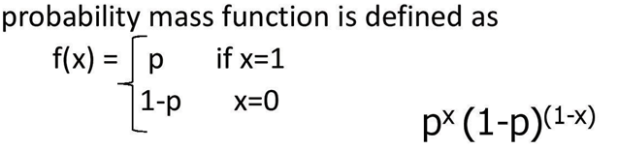
Bernouilli
Bernouilli trial: If there is only 1 trial with probability of success p and probability of failure 1-p, this is called a Bernouilli distribution. (special case of the binomial with n=1)
Probability of success:
Probability of failure:

Slide 86
Bernouilli
For Bernouilli (n=1)
E(X) = p
Var (X) = p(1-p)

Slide 87
Multinomial distribution
The multinomial is a generalization of the binomial.
It is used when there are more than 2 possible outcomes
partitioning n trials into 3 or more outcomes (with probabilities: p_{1,} p_{2,} p_{3,}..)
General formula for 3 outcomes:

Slide 88
Multinomial example
randomly choosing 8 people from an audience that
contains 50% democrats, 30% republicans, and 20% green
party, what’s the probability of choosing exactly 4
democrats, 3 republicans, and 1 green party member?

Slide 89
Poisson Distribution
Poisson distribution is for counts
if events happen at a constant rate over time, the Poisson distribution gives the probability of X number of events occurring in time T.
where λ = expected number of hits in a given time period

Slide 90
Poisson Distribution
The Poisson distribution models counts, such as the number of new cases of covid
The distribution tells you the probability of all possible numbers of new cases, from 0 to infinity.
If X= # of new cases
X ~ Poisson (λ), then the probability that X=k (a particular count) is:

Slide 91
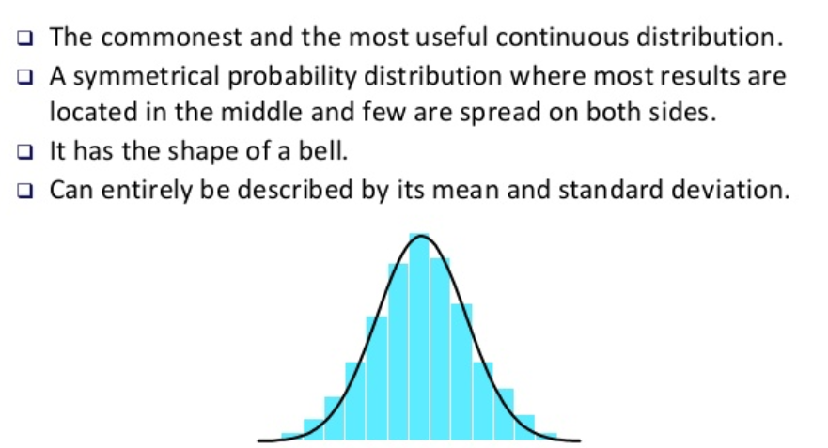
Gaussian Distribution

Slide 92
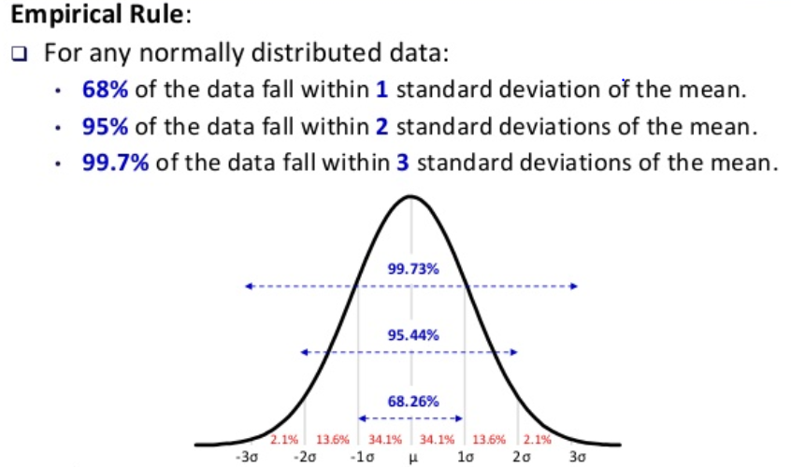
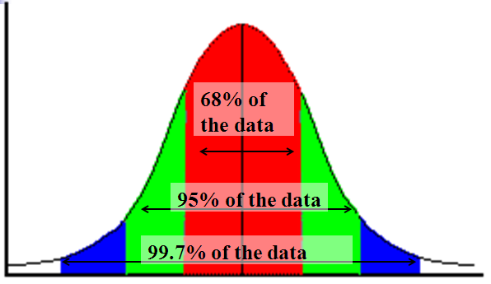
Gaussian Distribution

Slide 93
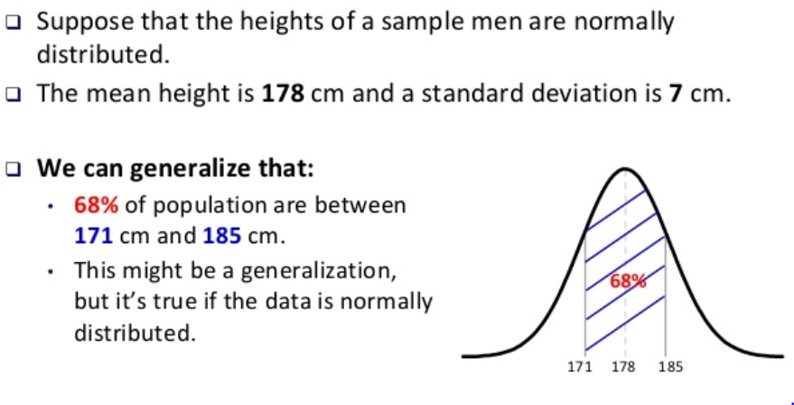
Gaussian Distribution

Slide 94
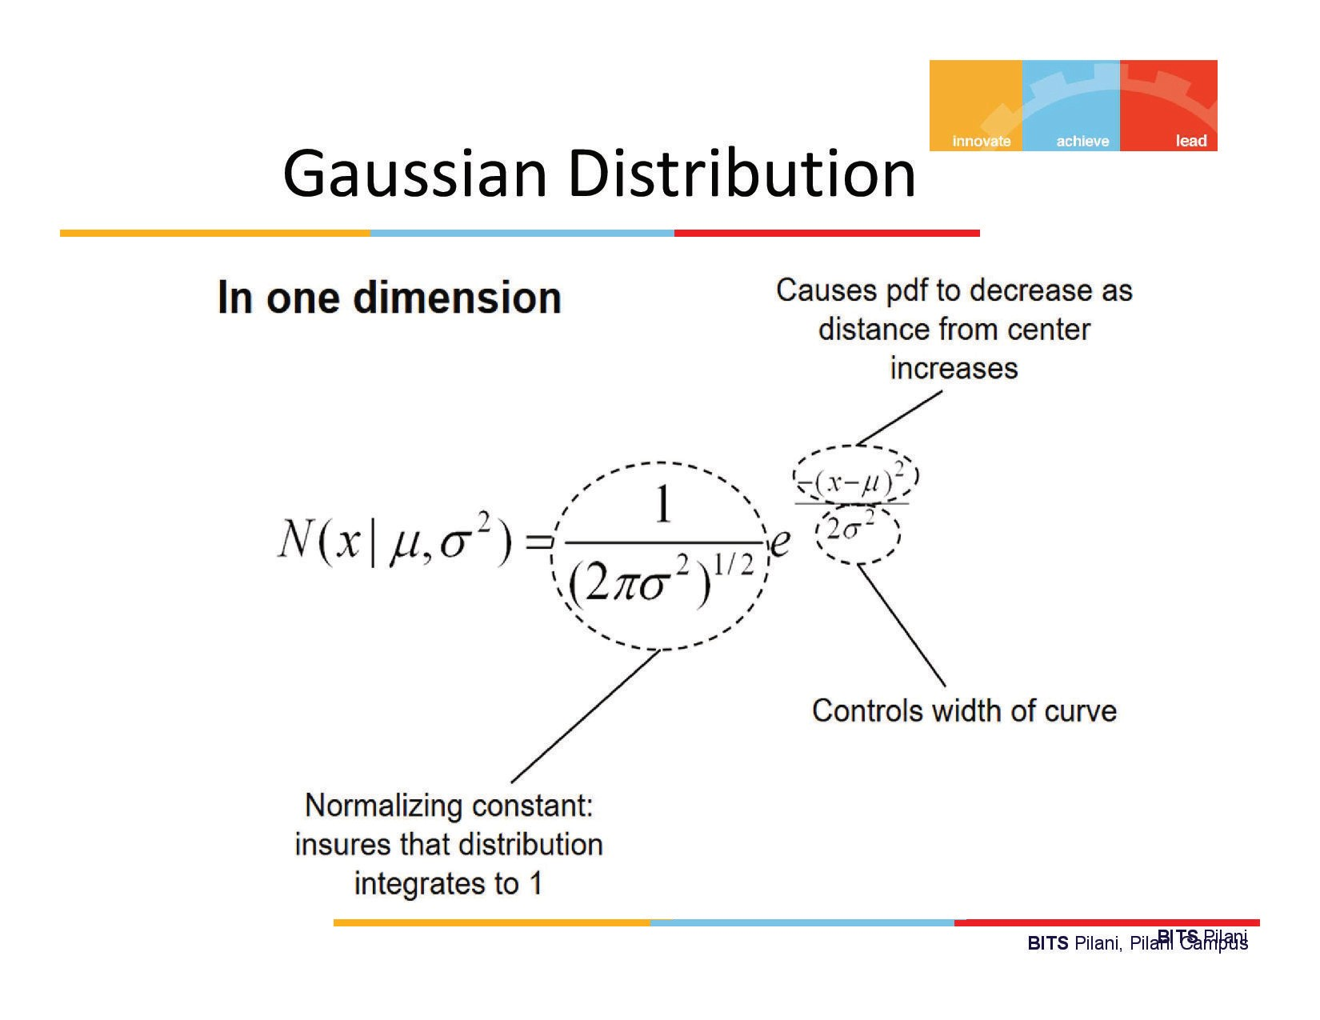

Slide 95
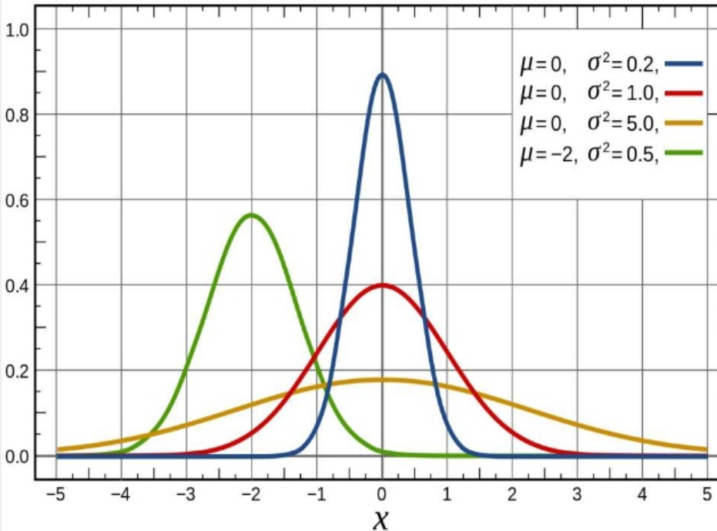
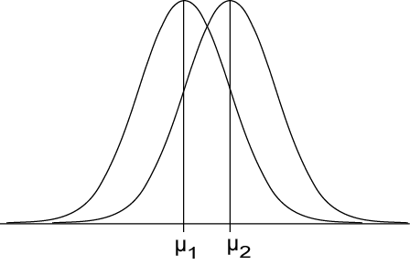
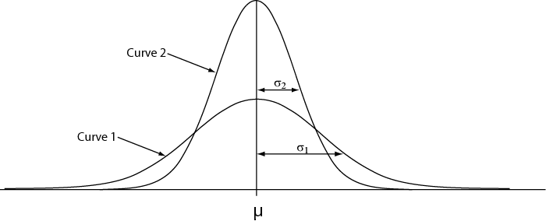
Gaussian Distribution
μ controls location
σ controls spread

Slide 96
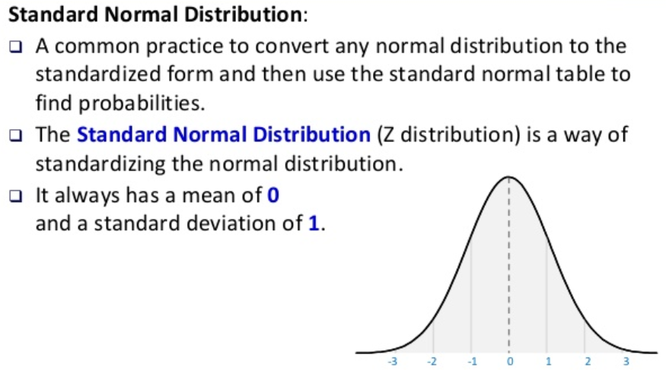
Standard - Gaussian Distribution

Slide 97
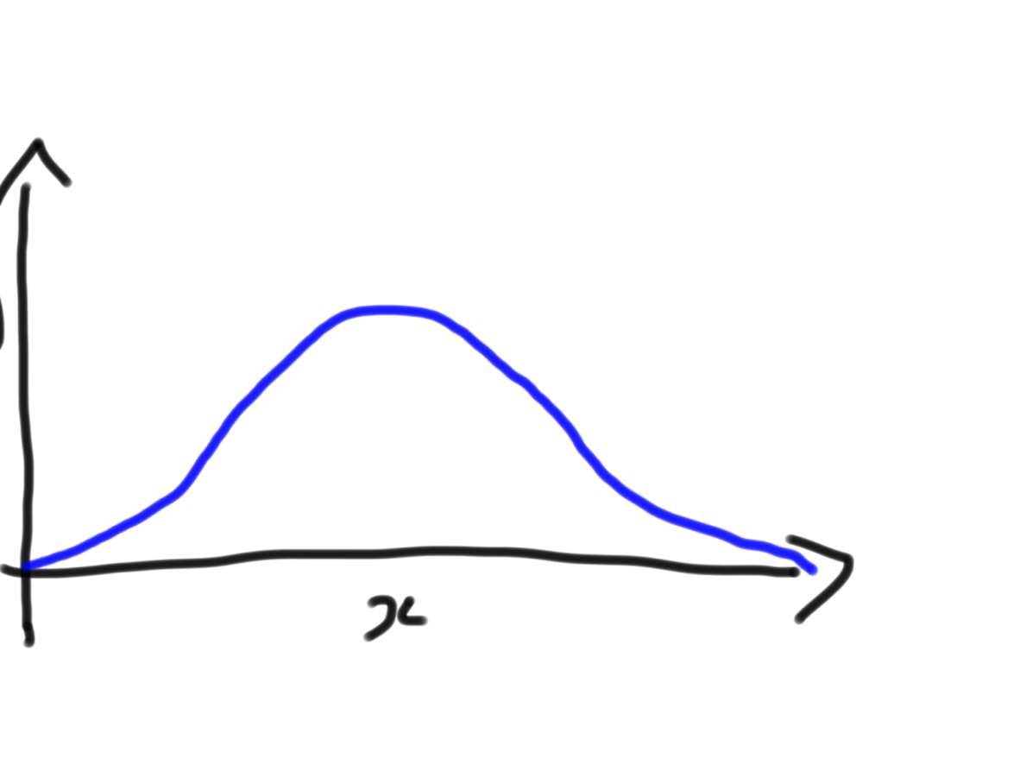

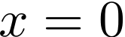

The Standard Normal
2
Z ⇠ N(µ = 0, σ = 1)
Mean (µ) = 0 Variance (σ²) = 1

Slide 98
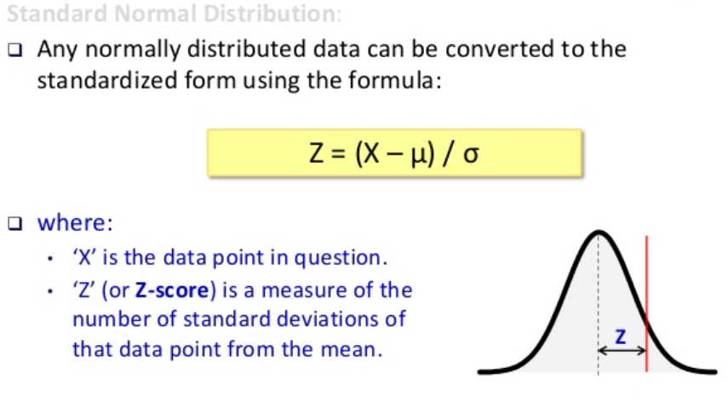
Standard - Gaussian Distribution

Slide 99
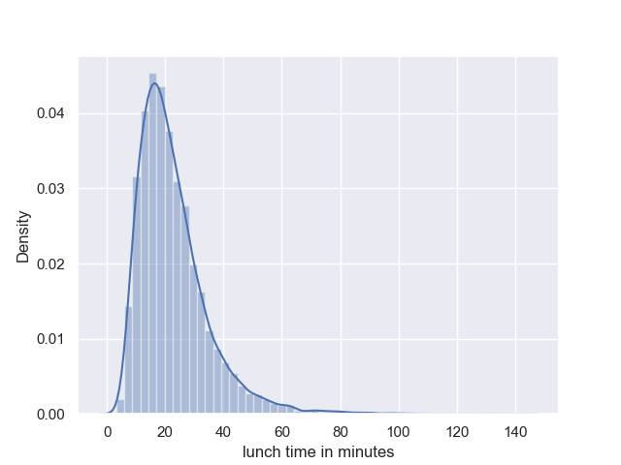
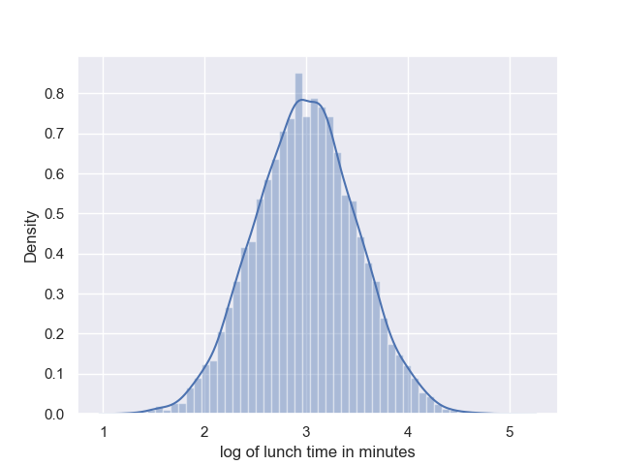
Log Normal Distribution

Slide 100
Decision Theory

Slide 101
Decision Theory
Suppose x is an input vector together with a corresponding vector t of target variables
Goal: predict t given a new value for x.
The joint probability distribution p(x, t) provides a complete summary of the uncertainty associated with these variables.
Determination of p(x, t) from a set of training data is called inference and is a difficult problem.

Slide 102
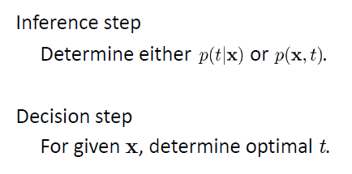
Decision Theory

Slide 103
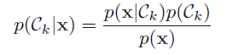
Example : Medical diagnosis problem
Input: X-ray image of a patient
Input vector x is the set of pixel intensities in the image
Output: Presence of cancer = Class C1,
Absence of cancer, = Class C2.
Choose t to be a binary variable such that
t =0 corresponds to C1 and t =1 corresponds to C2.
We are interested in the probabilities of the two classes given the image, which are given by p(C_{k}|x).
Using Bayes’ theorem,

Slide 104
Minimum Misclassification Rate
Divide the input space into regions Rk called decision regions, one for each class, such that all points in Rk are assigned to class Ck
Boundaries between decision regions are called decision boundaries or decision surfaces
A mistake occurs when an input vector belonging to class C1 is assigned to class C2 or vice versa.

Slide 105
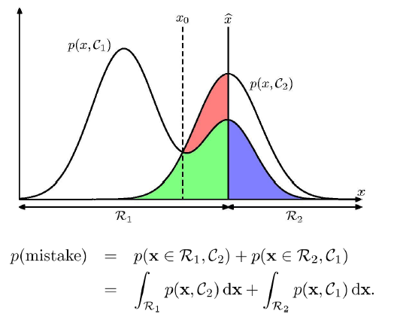
Minimum Misclassification Rate

Slide 106

Minimum Misclassification Rate

Slide 107
References
https://web.stanford.edu/~boyd/vmls/vmls.pdf
https://ocw.mit.edu/resources/res-6-012-introduction-to-probability-spring-2018/index.htm
https://web.stanford.edu/class/cs109/
http://cs229.stanford.edu/section/cs229-linalg.pdf
https://www.alextsun.com/files/distributions.pdf

Slide 108
Thank you !

